Slide 1
Differentiable Predictive Control with Safety Guarantees: A Control Barrier Function Approach
Wenceslao Shaw Cortez, Jan Drgona, Aaron Tuor, Mahantesh Halappanavar, and Draguna Vrabie
w.shawcortez@pnnl.gov
IEEE Conference on Decision and Control 2022

Slide 2
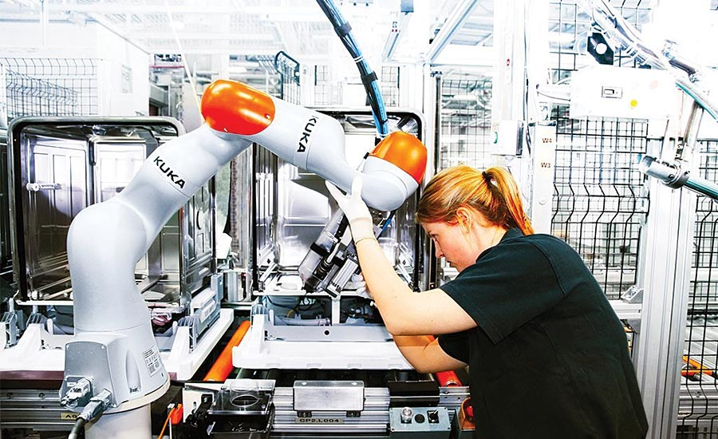
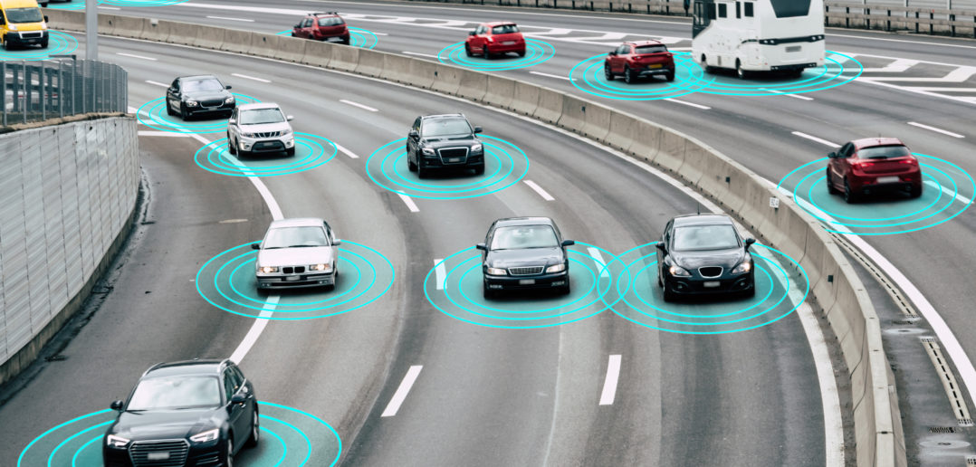
Motivation: Safety-Critical Control and Learning
Safety
Increased automation in human environments
Robots
Automated vehicles
Prevent system damage
Task specifications (not just stability)
Empirically shown to perform well
Implemented with low computational burden
Perforance highly dependent on:
Training set
Expert `behind-the-curtain’
Learning-based Control

Slide 3
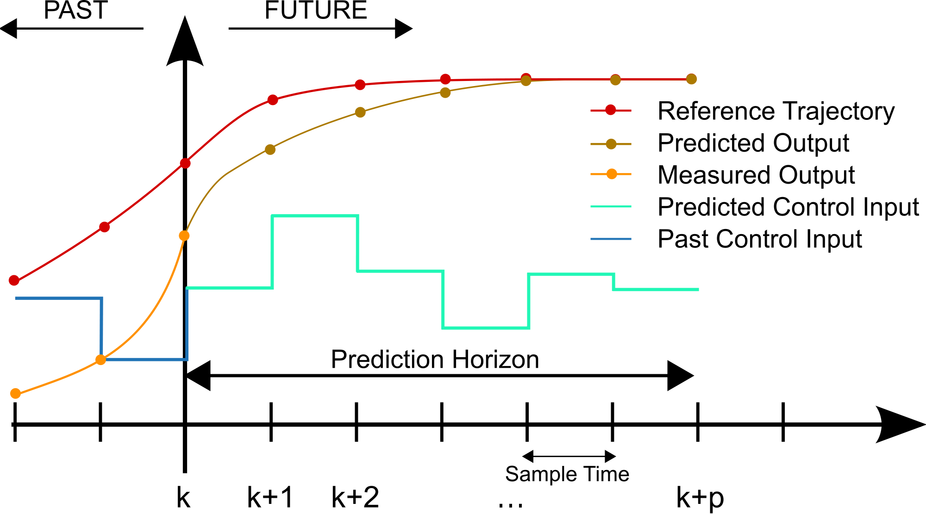
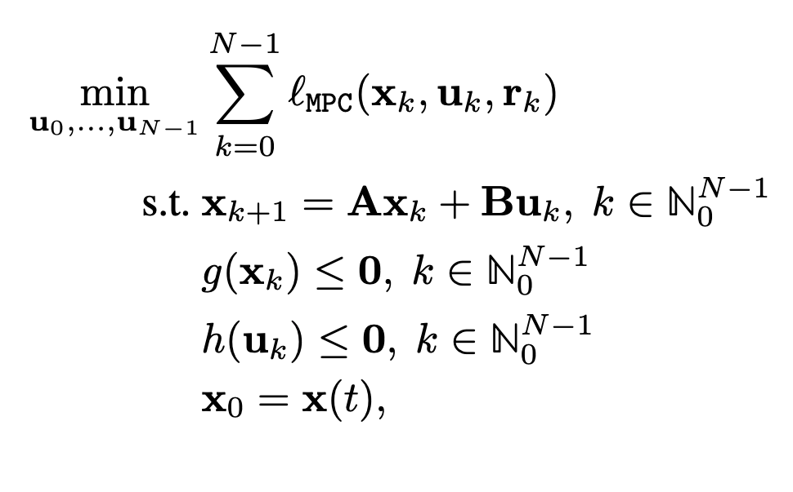
Model Predictive Control (MPC)
Cost:
Model Predictive Control
Advanced optimal control
First devised for process control in 1970’s
Handles constraints and optimality
Computationally expensive
Model:
Constraints:

Slide 4
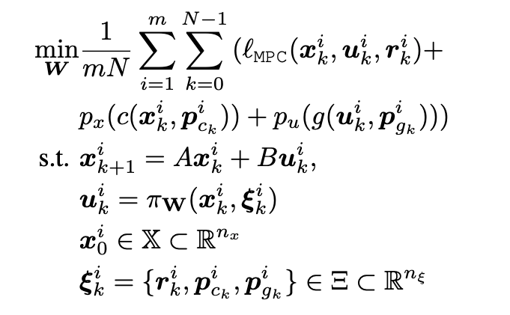
Differentiable Predictive Control (DPC)
From data to optimized control policy
MPC
DPC
Theoretical connection with MPC
Offline computation, no online optimization
Applicable to wide-range of systems
Time-varying reference/constraints
Limited guarantees of stability/constraint satisfaction
No robustness to perturbations (e.g. model uncertainty)
Discrete-time implementation
J. Drgoňa, A. Tuor, E. Skomski, S. Vasisht, and D. Vrabie, “Deep Learning Explicit Differentiable Predictive Control Laws for Buildings,” IFAC-PapersOnLine, vol. 54, no. 6, pp. 14–19, 2021.

Slide 5

Differentiable Predictive Control (DPC)
From data to optimized control policy
Theoretical connection with MPC
Offline computation, no online optimization
Applicable to wide-range of systems
Time-varying reference/constraints
Limited guarantees of stability/constraint satisfaction
No robustness to perturbations (e.g. model uncertainty)
Discrete-time implementation

Slide 6

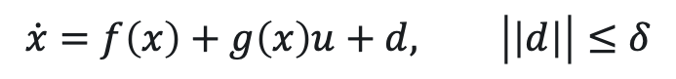
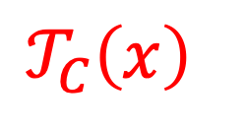
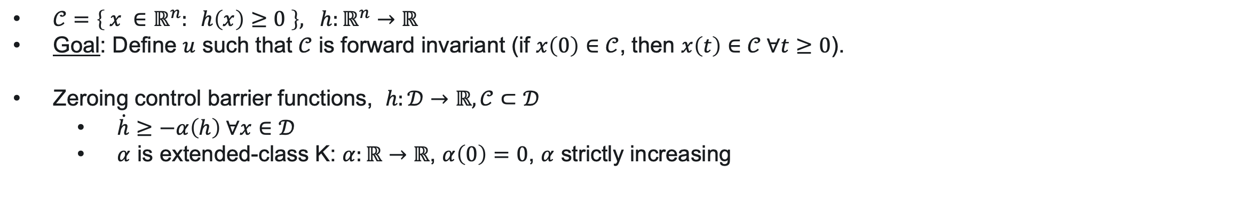

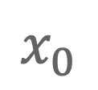
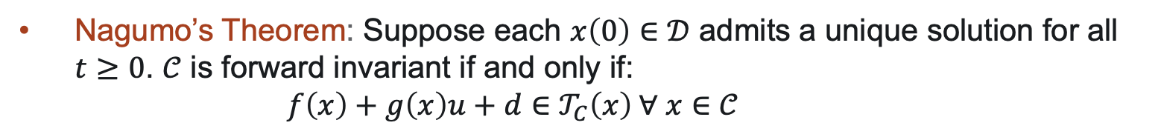

Zeroing Control Barrier Functions (ZCBFs)
$$\dot{x}=f\left(x\right)+g\left(x\right)u+d, \left|\left|d\right|\right|≤δ$$
$𝒞=\left\{ x ∈ℝ^{n}: h\left(x\right)≥0 \right\}, h:ℝ^{n}→ℝ$
Goal: Define $u$ such that $𝒞$ is forward invariant (if $x\left(0\right)∈𝒞$, then $x\left(t\right)∈𝒞 ∀t≥0$).
Zeroing control barrier functions, $h:𝒟→ℝ, 𝒞⊂𝒟$
$\dot{h}≥−α\left(h\right) ∀x∈𝒟$
$α$ is extended-class K: $α:ℝ→ℝ$, $α\left(0\right)=0$, $α$ strictly increasing
Nagumo’s Theorem: Suppose each $x\left(0\right)∈𝒟$ admits a unique solution for all $t≥0$. $𝒞$ is forward invariant if and only if:
$f\left(x\right)+g\left(x\right)u+d∈𝒯_{C}\left(x\right) ∀ x∈𝒞$
$$x_{0}$$
$$𝒯_{C}\left(x\right)$$
$$\dot{h}≥0, ∀x∈∂𝒞$$
$$𝒟$$
$$𝒞$$
Ames, A.D., X. Xu, J.W. Grizzle, and P. Tabuada. “Control Barrier Function Based Quadratic Programs for Safety Critical Systems.” IEEE Transactions on Automatic Control 62, no. 8 (2017): 3861–76.

Slide 7
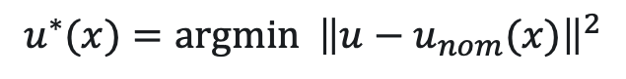
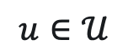
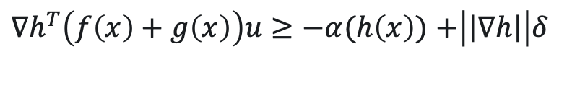
Zeroing Control Barrier Functions (ZCBFs)
$$\dot{x}=f\left(x\right)+g\left(x\right)u+d, \left|\left|d\right|\right|≤δ$$
$𝒞=\left\{ x ∈ℝ^{n}: h\left(x\right)≥0 \right\}, h:ℝ^{n}→ℝ$
Goal: Define $u$ such that $𝒞$ is forward invariant (if $x\left(0\right)∈𝒞$, then $x\left(t\right)∈𝒞 ∀t≥0$).
Zeroing control barrier functions, $h:𝒟→ℝ, 𝒞⊂𝒟$
$\dot{h}≥−α\left(h\right) ∀x∈𝒟$
$α$ is extended-class K: $α:ℝ→ℝ$, $α\left(0\right)=0$, $α$ strictly increasing
$$u^{∗}(x)=argmin {\left\|u−u_{nom}(x)\right\|}^{2}$$
$$u∈𝒰$$
$$x_{0}$$
$$𝒯_{C}\left(x\right)$$
subject to:
$∇h^{T}\left(f\left(x\right)+g\left(x\right)\right)u≥−α(h\left(x\right))$ $+\left|\left|∇h\right|\right|δ$
$$𝒟$$
$$𝒞$$
Ames, A.D., X. Xu, J.W. Grizzle, and P. Tabuada. “Control Barrier Function Based Quadratic Programs for Safety Critical Systems.” IEEE Transactions on Automatic Control 62, no. 8 (2017): 3861–76.

Slide 8
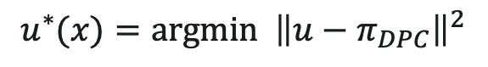
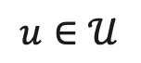
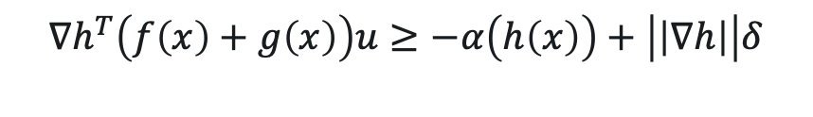
ZCBFs and DPC
Goal:
Combine ZCBFs and DPC for safe, learning-based control
DPC provides:
Structured learning methodology
Fast online implementation
ZCBFs provide:
Safety
Robustness
$$u^{∗}(x)=argmin {\left\|u−π_{DPC}\right\|}^{2}$$
$$u∈𝒰$$
subject to:
$$∇h^{T}\left(f\left(x\right)+g\left(x\right)\right)u≥−α\left(h\left(x\right)\right)+\left|\left|∇h\right|\right|δ$$
Limitations:
Objectives:
Safety only for continuous-time implementation
Requires QP to be solved at all times
Time-invariant
Training agnostic to barrier function
Sampled-data system
Reduce QP implementation
Time-varying sets
Make DPC ‘aware’ of ZCBFs

Slide 9



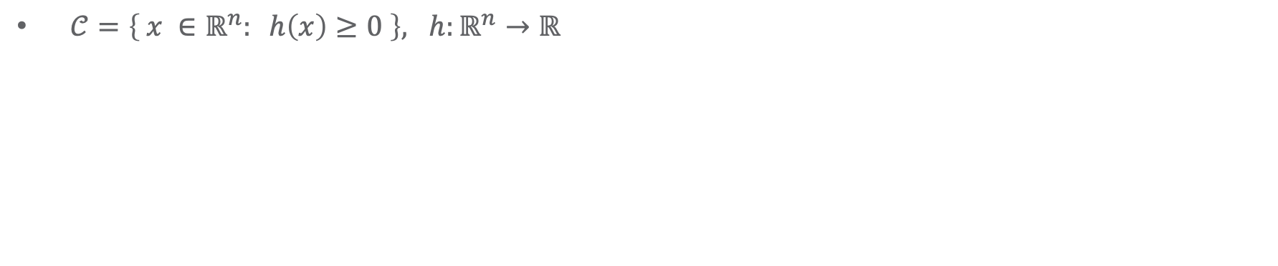
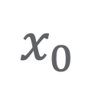
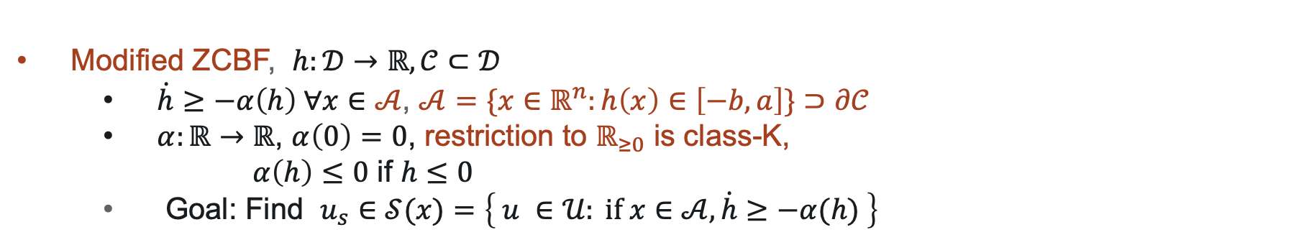
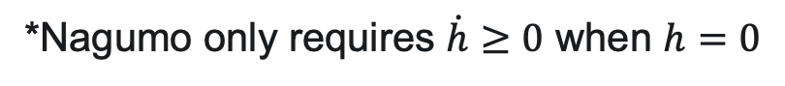

Modified ZCBFs
$𝒞=\left\{ x ∈ℝ^{n}: h\left(x\right)≥0 \right\}, h:ℝ^{n}→ℝ$
Zeroing control barrier functions, $h:𝒟→ℝ, 𝒞⊂𝒟$
$\dot{h}≥−α\left(h\right) ∀x∈𝒟$
$α$ is extended-class K: $α:ℝ→ℝ$, $α\left(0\right)=0$, $α$ strictly increasing
$$𝒜$$
*Nagumo only requires $\dot{h}≥0$ when $h=0$
Modified ZCBF, $h:𝒟→ℝ, 𝒞⊂𝒟$
$\dot{h}≥−α\left(h\right) ∀x∈𝒜$, $𝒜=\{x∈ℝ^{n}:h\left(x\right)∈\left[−b,a\right]\}⊃∂𝒞$
$α:ℝ→ℝ$, $α\left(0\right)=0$, restriction to $ℝ_{≥0}$ is class-K,
$α\left(h\right)≤0$ if $h≤0$
Goal: Find $u_{s}∈𝒮(x)=\left\{ u ∈𝒰: if x∈𝒜, \dot{h}≥−α(h) \right\}$
$$x_{0}$$
$$𝒞$$

Slide 10
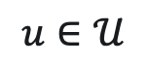
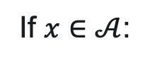
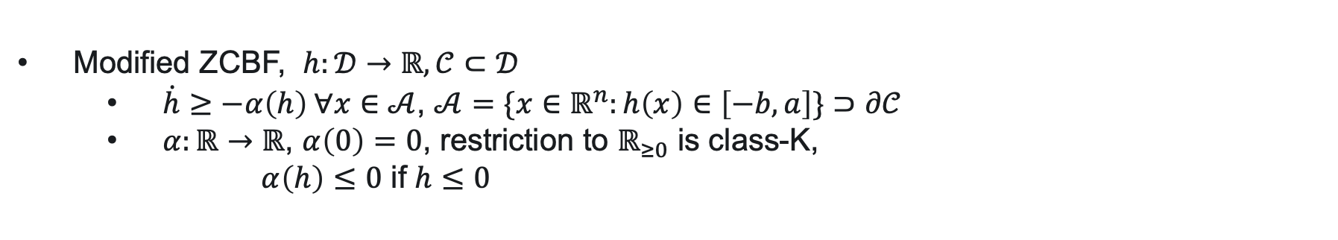
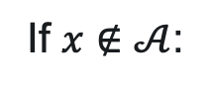

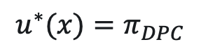
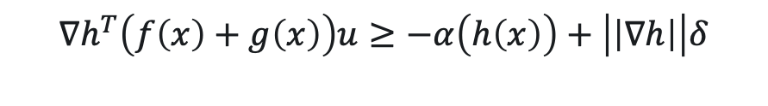
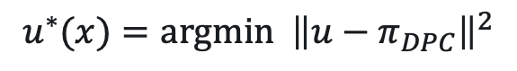
Modified ZCBFs
$𝒞=\left\{ x ∈ℝ^{n}: h\left(x\right)≥0 \right\}, h:ℝ^{n}→ℝ$
$$𝒜$$
Modified ZCBF, $h:𝒟→ℝ, 𝒞⊂𝒟$
$\dot{h}≥−α\left(h\right) ∀x∈𝒜$, $𝒜=\{x∈ℝ^{n}:h\left(x\right)∈\left[−b,a\right]\}⊃∂𝒞$
$α:ℝ→ℝ$, $α\left(0\right)=0$, restriction to $ℝ_{≥0}$ is class-K,
$α\left(h\right)≤0$ if $h≤0$
If $x∉𝒜$:
$$u^{∗}(x)=π_{DPC}$$
If $x∈𝒜$:
$$u^{∗}(x)=argmin {\left\|u−π_{DPC}\right\|}^{2}$$
$$u∈𝒰$$
$$x_{0}$$
subject to:
$$∇h^{T}\left(f\left(x\right)+g\left(x\right)\right)u≥−α\left(h\left(x\right)\right)+\left|\left|∇h\right|\right|δ$$
$$𝒞$$

Slide 11

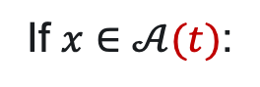
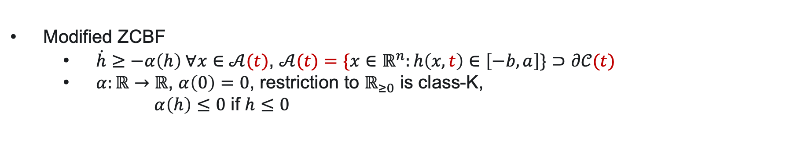
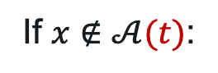
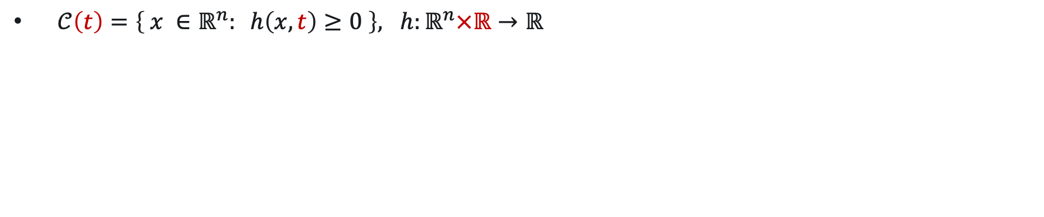
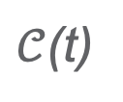
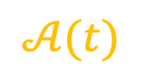
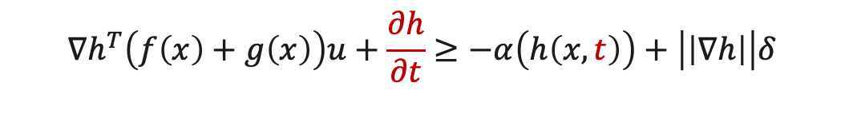
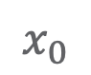
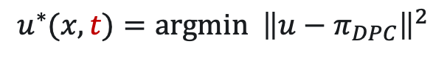
Modified ZCBFs
$𝒞\left(t\right)=\left\{ x ∈ℝ^{n}: h\left(x,t\right)≥0 \right\}, h:ℝ^{n}×ℝ→ℝ$
Modified ZCBF
$\dot{h}≥−α\left(h\right) ∀x∈𝒜(t)$, $𝒜(t)=\{x∈ℝ^{n}:h\left(x,t\right)∈\left[−b,a\right]\}⊃∂𝒞(t)$
$α:ℝ→ℝ$, $α\left(0\right)=0$, restriction to $ℝ_{≥0}$ is class-K,
$α\left(h\right)≤0$ if $h≤0$
Time slice
$$𝒜(t)$$
If $x∉𝒜(t)$:
$$u^{∗}(x)=π_{DPC}$$
If $x∈𝒜(t)$:
$$u^{∗}(x,t)=argmin {\left\|u−π_{DPC}\right\|}^{2}$$
$$u∈𝒰$$
subject to:
$$x_{0}$$
$$∇h^{T}\left(f\left(x\right)+g\left(x\right)\right)u+\frac{∂h}{∂t}≥−α\left(h\left(x,t\right)\right)+\left|\left|∇h\right|\right|δ$$
$𝒞$(t)
P. Roque, W. S. Cortez, L. Lindemann, and D. V. Dimarogonas, “Corridor MPC: Towards Optimal and Safe Trajectory Tracking,” in 2022 American Control Conference (ACC). 2022, pp. 2025–2032.

Slide 12
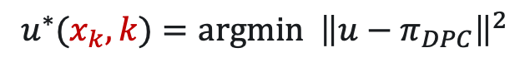

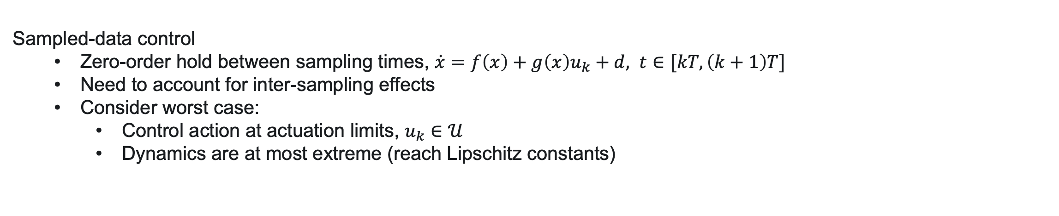
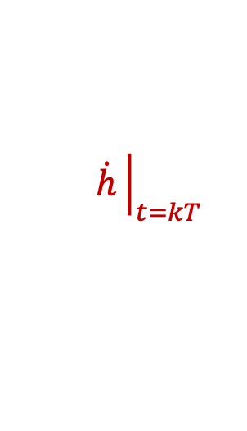

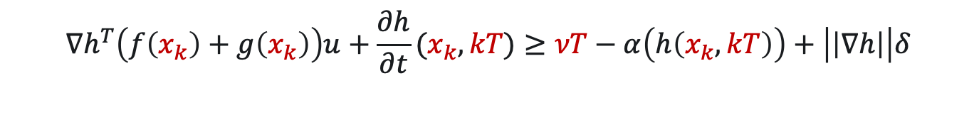
Modified ZCBFs: Sampled-Data System
Sampled-data control
Zero-order hold between sampling times, $\dot{x}=f\left(x\right)+g\left(x\right)u_{k}+d, t∈[kT, \left(k+1\right)T]$
Need to account for inter-sampling effects
Consider worst case:
Control action at actuation limits, $u_{k}∈𝒰$
Dynamics are at most extreme (reach Lipschitz constants)
$|\left(∇h^{T}\left(f\left(x\right)+g\left(x\right)u_{k}+d\right)+\frac{∂h}{∂t}\left(x,t\right)+α\left(h\left(x,t\right)\right)\right)−\left(∇h^{T}\left(f\left(x_{k}\right)+g\left(x_{k}\right)u_{k}+d_{k}\right)+\frac{∂h}{∂t}\left(x_{k},kT\right)+α\left(h\left(x_{k},kT\right)\right)\right)|≤νT$
$$\dot{h}$$
$$\dot{h}{\left.​\right|}_{t=kT }$$
$$u^{∗}(x_{k},k)=argmin {\left\|u−π_{DPC}\right\|}^{2}$$
$$u∈𝒰$$
subject to:
$$∇h^{T}\left(f\left(x_{k}\right)+g\left(x_{k}\right)\right)u+\frac{∂h}{∂t}(x_{k},kT)≥νT−α\left(h\left(x_{k},kT\right)\right)+\left|\left|∇h\right|\right|δ$$

Slide 13
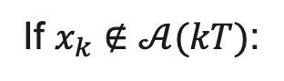
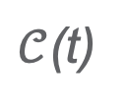
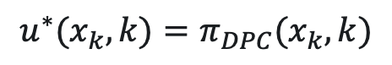
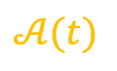
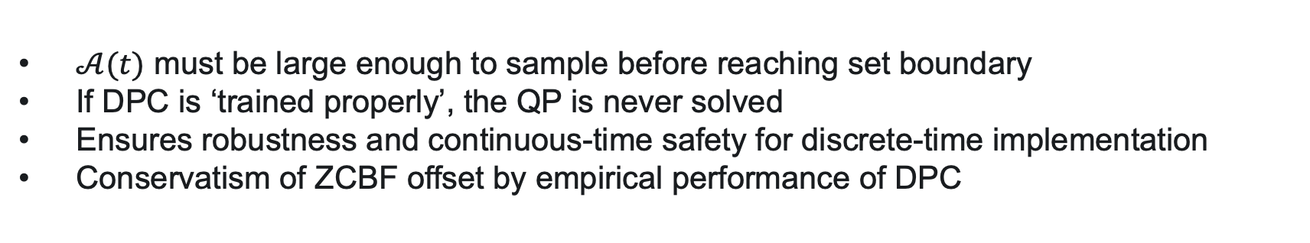
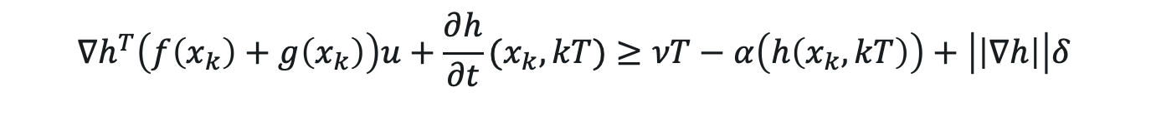
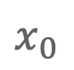
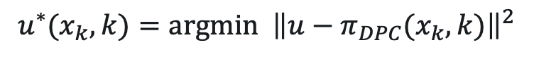
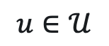
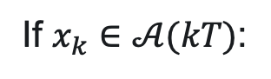

ZCBF and DPC Overview
$$𝒜(t)$$
If $x_{k}∉𝒜(kT)$:
$$u^{∗}(x_{k},k)=π_{DPC}(x_{k}, k)$$
$$x_{0}$$
If $x_{k}∈𝒜(kT)$:
$$u^{∗}\left(x_{k}, k\right)=π_{ZCBF}\left(x_{k}, k\right)≔$$
$$u^{∗}(x_{k},k)=argmin {\left\|u−π_{DPC}(x_{k}, k)\right\|}^{2}$$
$𝒞$(t)
$$u∈𝒰$$
subject to:
$$∇h^{T}\left(f\left(x_{k}\right)+g\left(x_{k}\right)\right)u+\frac{∂h}{∂t}(x_{k},kT)≥νT−α\left(h\left(x_{k},kT\right)\right)+\left|\left|∇h\right|\right|δ$$
Observations:
$𝒜(t)$ must be large enough to sample before reaching set boundary
If DPC is ‘trained properly’, the QP is never solved
Ensures robustness and continuous-time safety for discrete-time implementation
Conservatism of ZCBF offset by empirical performance of DPC

Slide 14


DPC: Offline Training with Barriers
Penalty-based Training:
DPC Training:
$\dot{h}≥−α\left(h\right)$
Want to train DPC with barrier to avoid conflict
Finite-difference approximation:
$$c_{h}(x_{k}^{i}, x_{k+1}^{i},k, k + 1)= h(x_{k+1}^{i}, k + 1) − h(x_{k}^{i}, k)+ α(h(x_{k}^{i}, k)) −δ$$
Alternative method:
Projection-based implementation
$$u_{k}^{i}=π_{ZCBF}( x_{k}^{i}, k,π_{W}\left(x_{k}^{i}, ξ_{k}^{i}\right))$$
Software products:
https://github.com/pnnl/neuromancer
https://github.com/pnnl/slim

Slide 15




ZCBF and DPC Implementation
Barrier only
DPC only (poorly trained)
ZCBF+DPC (poorly trained)
ZCBF+DPC (ideally trained)
$$\dot{x} = Ax + u + w\left(t\right)$$
$$h\left(x, t\right):= ε − ∥x − x_{r} \left(t\right)∥_{2}^{2}$$

Slide 16

Conclusion and Future Directions
Summary
Learning-based DPC control with hard safety guarantees
Event-triggered-like safety condition
Safety QP never enforced if system is ‘trained well’
Extend to more general systems: $\dot{x}=f(x,u)$
Synthesize ZCBFs via learning methods with guarantees
Adaptive DPC with safety guarantees
Next steps
w.shawcortez@pnnl.gov

